Slide 1
Seva School
Expansion

Slide 2
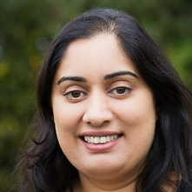
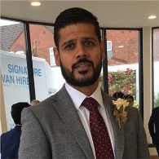
Welcome
Sukhy Sanghera
Seva School Principal
Sunny Singh Heer
Trustee, Chair of Finance Audit Risk & Buildings

Slide 3
Agenda
What is the Seva School Expansion
What works are being delivered
Key Milestones
Impact on School
Traffic Management Plan (TMP)
Questions

Slide 4
Seva School
Expansion

Slide 5
UPDATE: Works start first
week of April
Seva School
Expansion
Contracts for the multi million pound Seva School expansion have now been signed. Work will soon be underway to deliver the long term needs of the school!

Slide 6
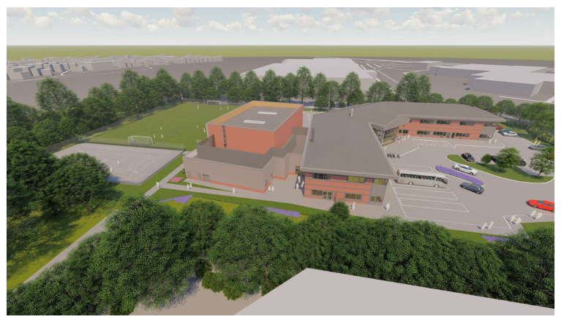
Capital Programme
What does capital programme mean?
Expansion of Seva School in line with Department for Education (DfE) specification
One big all-through campus incorporating Link and Eden House
Educational facilities for pupils in Reception to year 11
Expansion and Full refurbishment of Link and Eden House
A programme is a period of time for the capital expansion to be fully delivered.

Slide 7
What is
being
delivered

Slide 8
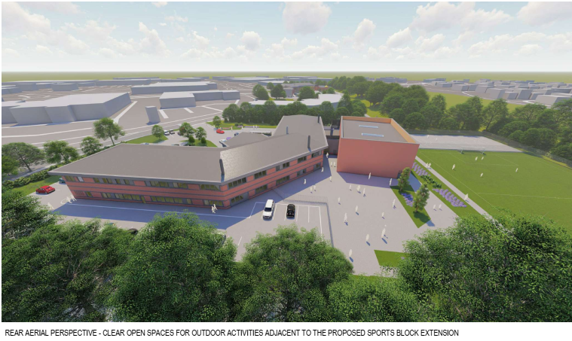
Eden House
EDEN HOUSE SITE
New 3G sports pitch with floodlights, this is Sports England approved
New Multi Use Games Area (MUGA)
New Indoor Sports Hall with changing/shower facilities
New Dining space
New Library
Special Educational Needs (SEN) Facilities
State of the art new classrooms including Science laboratories, ICT and Business suite

Slide 9
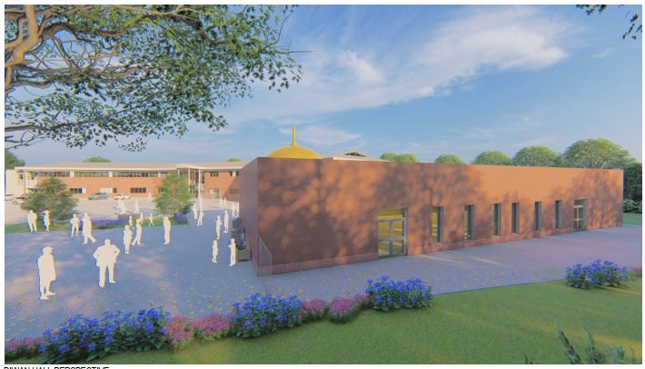
Link House
LINK HOUSE SITE
New Multi Use Games Area (MUGA)
New Diwan Hall (Sikh Faith Education Facility) with shoe room
New enclosed stairwells for improved access
New extended Kitchen with new kitchen equipment
New Library
Flexible studio
Fully refurbished new classrooms including Music, Dance, Drama Art, ICT, Design and Food Technology.

Slide 10
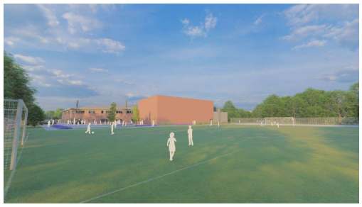
Key Milestones
March 2023 | B&K commence on site and take full access of Eden House site.
Autumn 2023 | 3G sports pitch complete and ready for use
Easter 2024 | Eden House fully complete. School moves into and has full access of Eden House. B&K take full access of Link House site
Easter 2025 | Link House fully complete. School decants across both sites
Summer 2025 | External and landscaping works delivered. Capital programme delivered and site fully operational
** dates currently provisional and subject to change

Slide 11
Impact on School
School is a live environment – provides challenges to us all and B&K
To ensure quality of good education is maintained
Teamwork
There will be inconveniences
Endeavour to give as much notice as possible to changes
The school will need to be responsive to B&K requests

Slide 12
Key Immediate Change
We need to move towards a temporary traffic management plan (TMP)
What do I mean by TMP?
Pupil arrangements for drop off and pick up
Why?
Eden House car park will be fully occupied by B&K
TMP must comply with the imposed travel plan on the school from Coventry City Council. Failure to comply with this can result in penalties
So we URGE YOU ALL TO WORK AS A TEAM WITH US
.

Slide 13
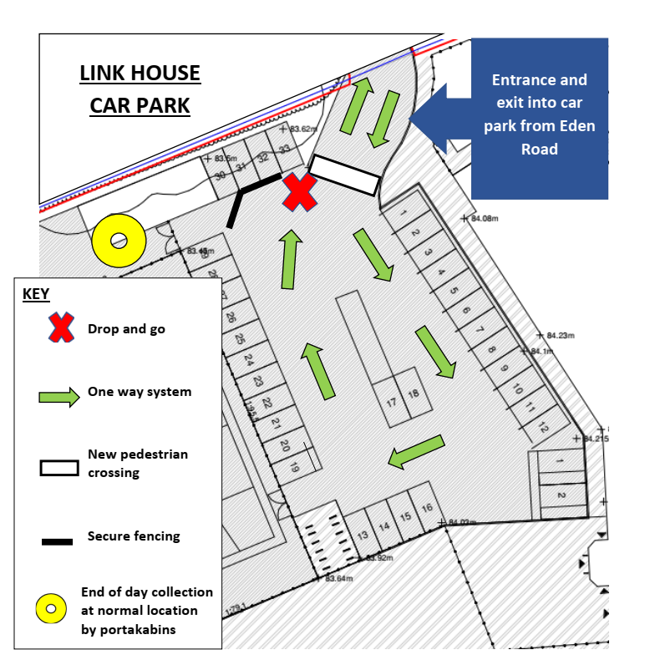
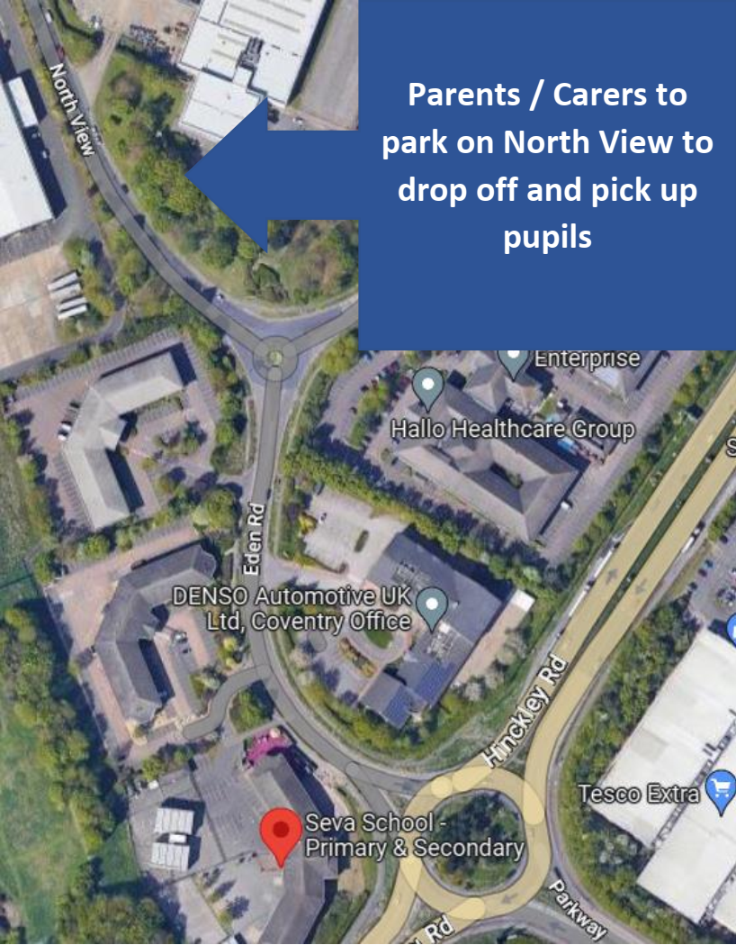
Drop Off and Pick Up Locations
Link House Car Park
North View

Slide 14
Primary Drop Off and Pick Up
KEY CHANGES
Drop Off
YR & Y1 only can park in Link House
Y2 to Y6 can use the drop and go, not allowed to park in Link House.
Staff member will be at the drop and go location
Pick Up
School day finishes 5 minutes early
YR & Y1 only can park in Link House
Y2 & Y6 must park on North View and walk to collect child(ren) from normal collection point at Link House
PLEASE NOTE - If you have a child(ren) in Primary and Secondary, you must collect all children when Secondary day ends. The Primary child will be collected by their Secondary sibling at the end of the school day from a holding classroom.
NEW DROP OFF ARRANGEMENTS
YEAR | MON - FRI | PARKING LOCATION
YR - Y1 | 8.10am - 8.30am | Can park in Link House Car Park
Y2 - Y6 | 8.10am - 8.30am | Turning circle in Link House Car Park - Drop and Go
NEW PICK UP ARRANGEMENTS
YEAR | MON / WED / FRI | TUES / THURS | PARKING LOCATION
YR - Y1 | 2.55pm | 3.55pm | Can park in Link House Car Park
Y2 - Y6 | 2.55pm | 3.55pm | Ensure you park on North View and walk to collect child(ren)

Slide 15
Secondary Drop Off and Pick Up
KEY CHANGES
Drop Off
Y7 to Y11 must park/drop off on North View
Pupils must enter the school using the walkway next to Reception
Pick Up
Y7 only can park in Link House
Y8 to Y11 must park on North View and either wait for their child(ren) to walk to the car or collect by walking to the normal collection point at Link House.
PLEASE NOTE - If you have a child(ren) in Primary and Secondary, you must collect all children when Secondary day ends. The Primary child will be collected by their Secondary sibling at the end of the school day from a holding classroom
NEW DROP OFF ARRANGEMENTS
YEAR | MON - FRI | PARKING LOCATION
Y7 - Y11 | 8.10am - 8.30am | Ensure you park/drop off on North View
NEW PICK UP ARRANGEMENTS
YEAR | MON / WED / FRI | TUES / THURS | PARKING LOCATION
Y7 | 3.15pm | 4.15pm | Can park in Link House Car Park
Y8 - Y11 | 3.15pm | 4.15pm | Ensure you park/collect pupils from North View

Slide 16
New TMP Implementation
Provisional go LIVE date is Monday 27th March 2023
When exiting Link House car park you must turn left and drive up to the roundabout
No parking behind or on coach spaces
No parking on bus stop
No turning or parking in DENSO entrance – we have received complaints from DENSO
Drive slowly and be considerate to our pupils, parents and other business park users
Arrive and depart in a timely manner

Slide 17
Community Use
As part of our planning approval, we have secured the agreement to hire out specific facilities out of school hours. This will include the hiring of the 3G sports pitches, 2 multi use games areas (MUGA’s), indoor sports hall and the Diwan Hall.
We are currently in process of developing how the community use hiring of our facilities will operate and the associated costs. If you do have an initial interest, please get in touch by emailing bookings@seva.coventry.sch.uk

Slide 18
Thank you
Questions

